Slide 1
Clustering of Energy Usage in the US
E R M S Chathurani Ekanayake
811186919

Slide 2
Data Description
Data Description
Data contains information about Energy in the United States.
Data table contains 608,565 rows and 20 variables which provides information
Data provides information on various aspects related to fuel like its cost, sulphur and ash contents, the heat produced per unit resource, suppliers, and many more.

Slide 3
Da Problem Statement ta Description
Problem statement: Analysis of Energy resources is key for better energy management in the country. The aim is to identify similarities in energy usage and try to cluster in order to find insights from the data

Slide 4
Techniques Used
The machine learning technique used for this is “K-means clustering”
Imputing the missing values by finding MEDIAN
Set seed
Data partition – training -75%
Normalization – Centre and scale
Silhouette and WSS method to identify the clusters
DBSCAN
Multiple linear Regression
ANOVA

Slide 5
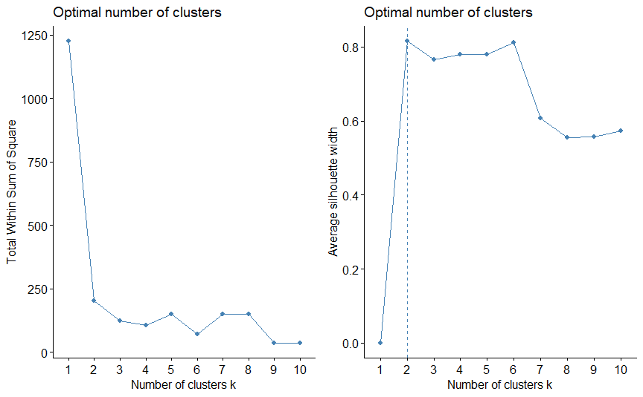
Silhouette and WSS method
Based on the silhouette method, the number of clusters decided as 2

Slide 6
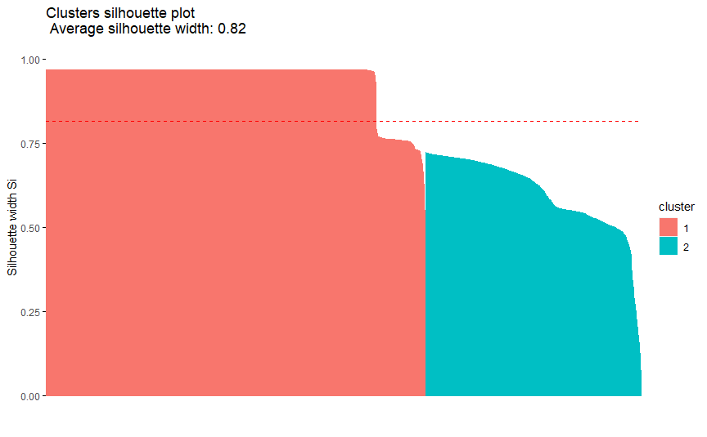
Average Silhouette
The average silhouette is 0.82 and it proved this is better clustering of data

Slide 7
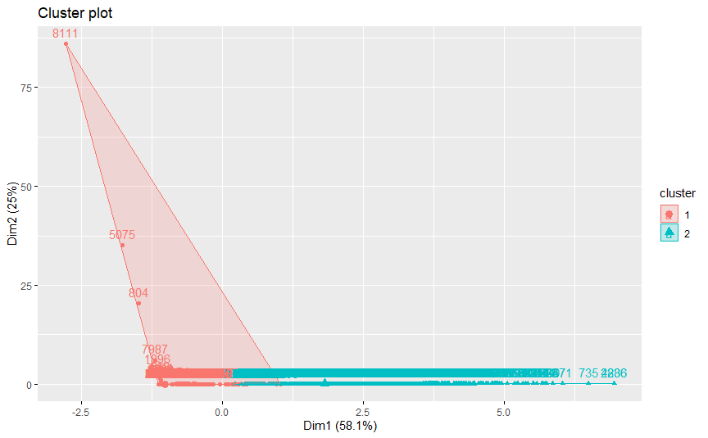
The cluster plot of two clusters

Slide 8
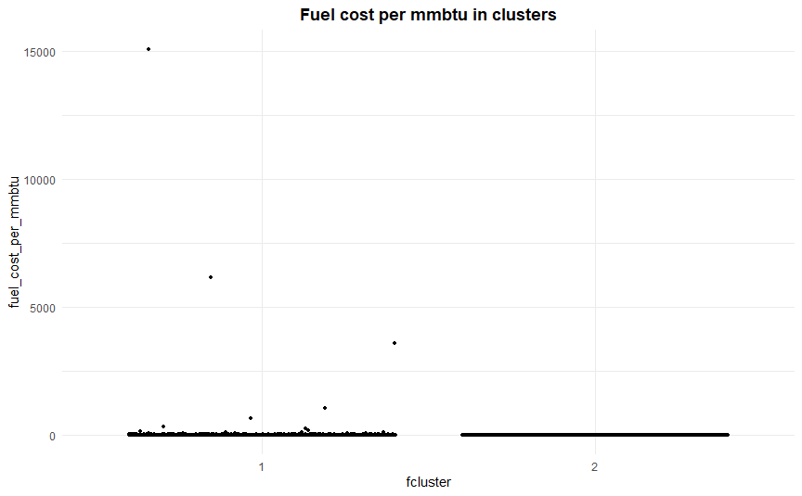
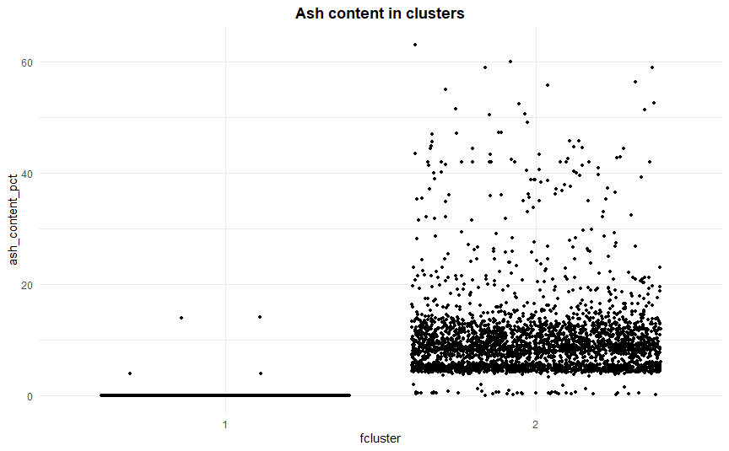
Fuel cost and ash content of clusters
Fuel cost is high in the first cluster
Ash content is high in the second cluster

Slide 9
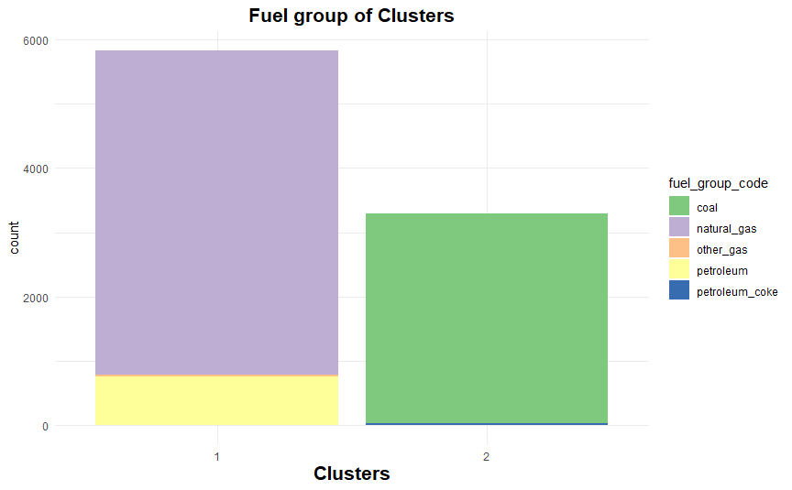
Fuel group of clusters
The first cluster contains majority of natural gas while the second cluster includes coal
the most

Slide 10
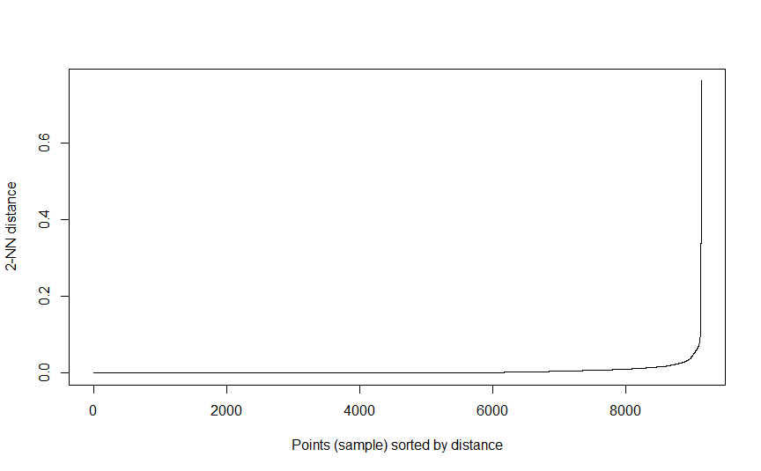
DBSCAN

